Slide 1

CAT Assessment 2024

Slide 2
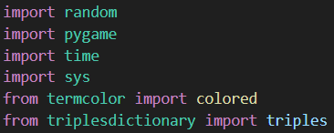

Imports and Inits
Random is used to generate coords
Pygame is used for visuals and music
Time is used for time.sleep
Sys is used to exit
Termcolor is used to print coloured text
Pygame.mixer is used to play music

Slide 3
Functions

Slide 4
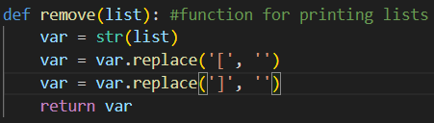
Remove
Function for printouts
Intakes a list
Removes the end brackets
Returns list as str

Slide 5
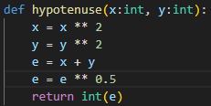
Hypotenuse
Function to find length of hypotenuse
Intakes x length and y length
Uses Pythagorean theorem
Returns as int

Slide 6
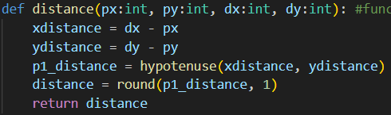

Distance
Function to find distance
Intakes 2 x values and 2 y values
Uses hypotenuse
Returns distance

Slide 7
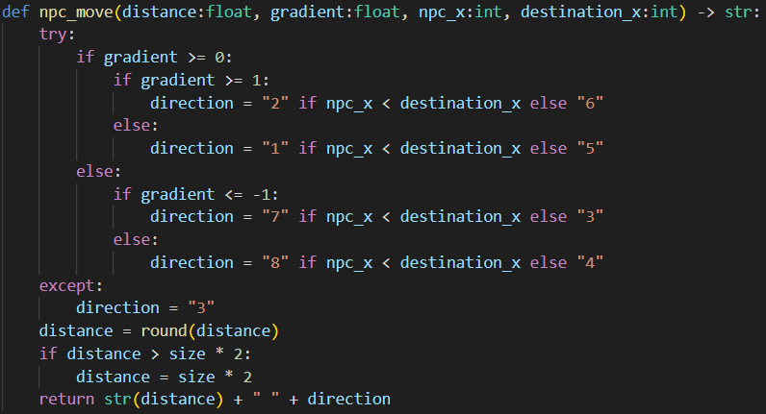
npc_move
Function to calculate npc’s
move
Note that this doesn’t actually move the npc
Returns in format distance
<space> direction

Slide 8
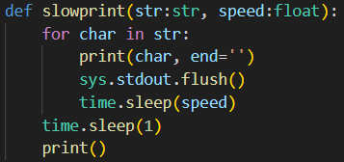
slowprint
Intakes a string and a speed
Prints out the string like its typing
Prints an empty line at the end to go to the next line

Slide 9
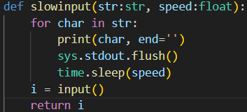
slowinput
Intakes a string and a speed
Prints out the string like slowprint
Then has an empty input to input at the end
Returns the input to the variable

Slide 10
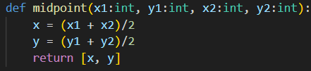
Midpoint
Function to find the midpoint
Averages both x values and both y values
Returns as a list

Slide 11
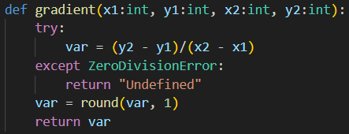
Gradient
Function to find gradient
Uses rise over run
If the x values are the same then it is an undefined gradient
Rounds it to one decimal place

Slide 12
printstats
Function to print name and coords
Intakes the dictionary
Uses slowprint
Prints using f strings

Slide 13
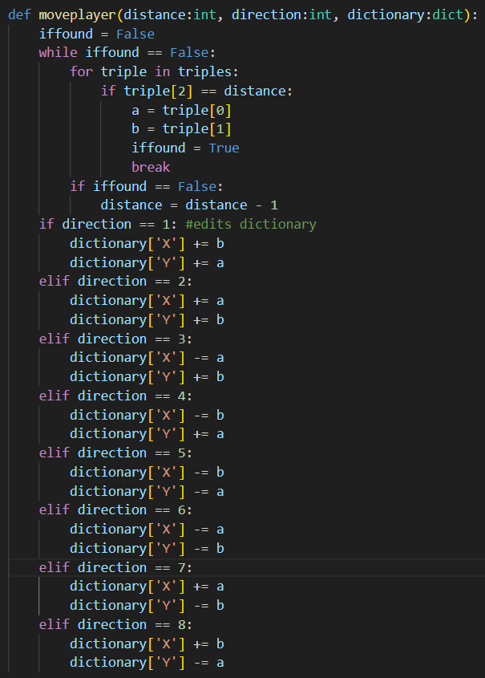
moveplayer
First section is to find the triple
Second section edits the dictionary
If the triple is not found then it will continue subtracting by one until it is valid

Slide 14
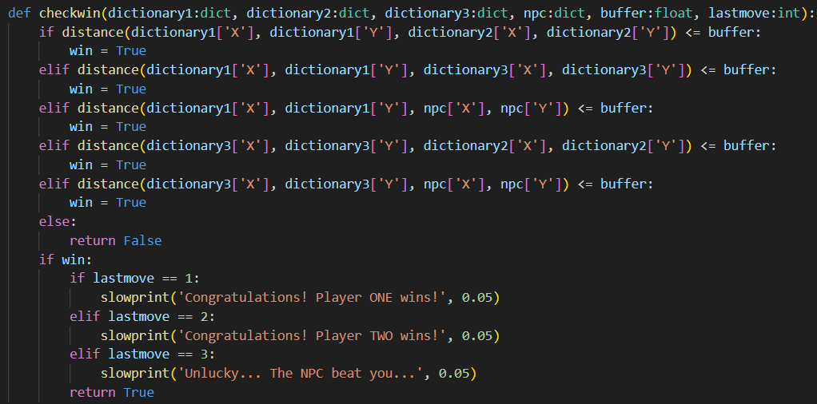
checkwin
Function to check for winner
Intakes dictionaries, buffer and last move
Uses distance
Checks if distance is between two places is less than the buffer
Prints congratulations and returns true if wins, else returns false

Slide 15
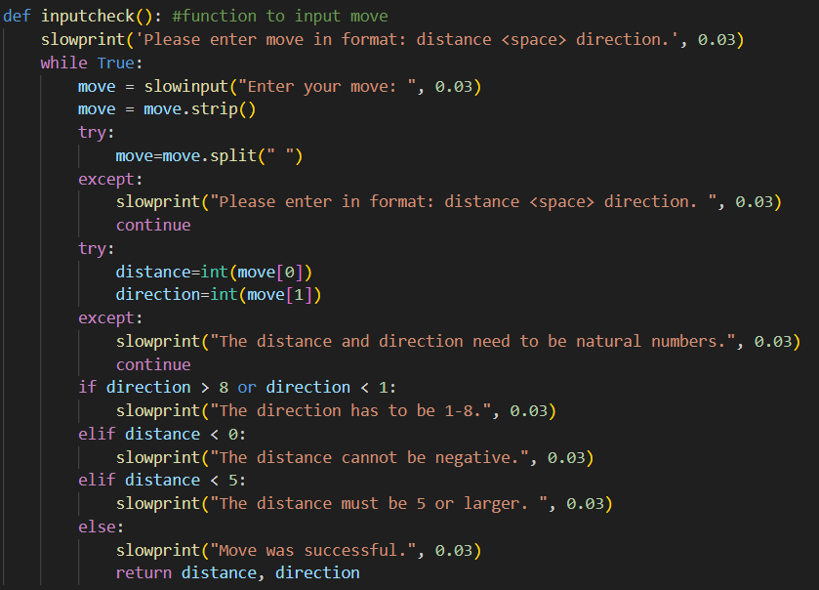
Inputcheck
Checks player input for move
Uses a while True loop, also uses try and except to catch errors
Returns distance and direction

Slide 16
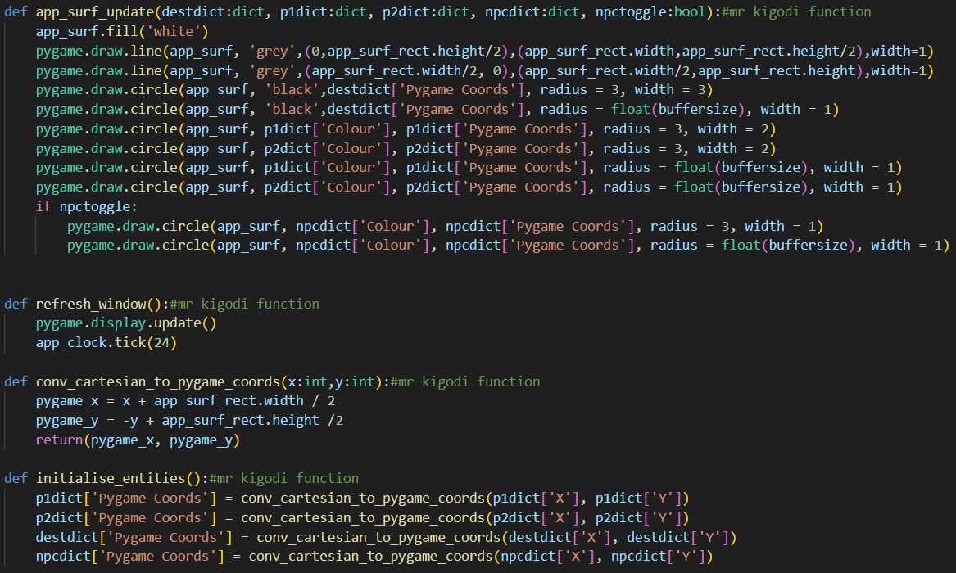
Mr Kigodi’s Functions
The functions that Mr Kigodi gave us
App_surf_update now includes the buffer and the npc
Initialise_entities only changes pygame coords

Slide 17
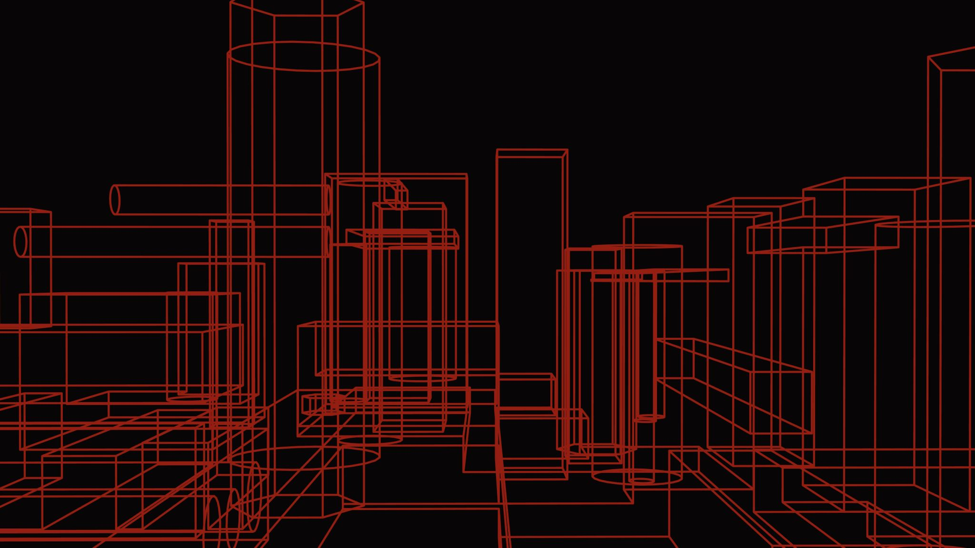
Customisation

Slide 18
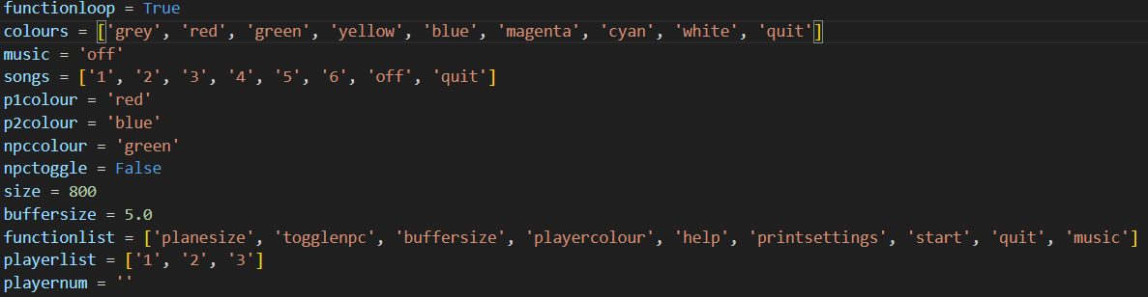
Some things for the customisation
These are variables and lists for customisation
They are also the defaults

Slide 19
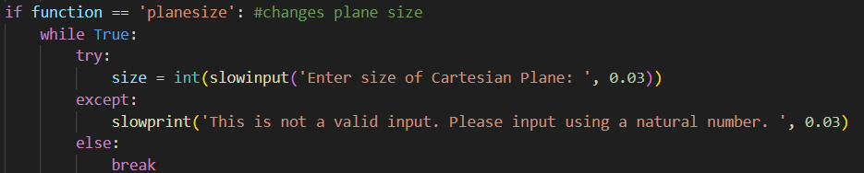
Planesize
Changes size of plane
Uses try and except

Slide 20
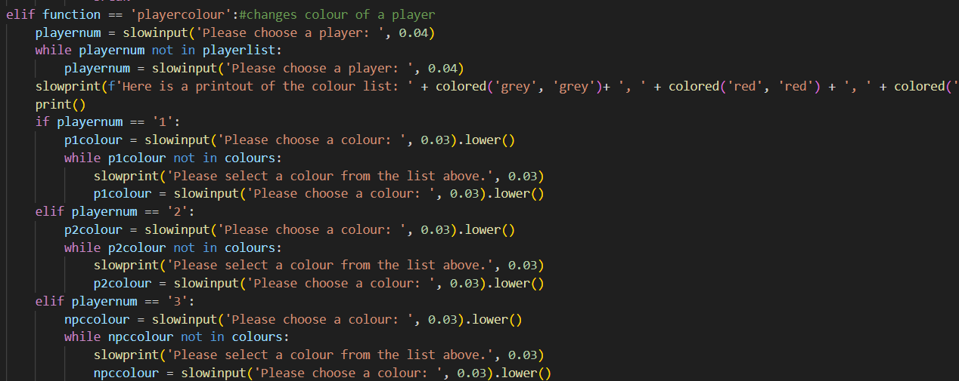
Playercolour
Changes colour of players
Has separate branches for each player
Prints colour list
(The list is too big to
fit on the page)

Slide 21
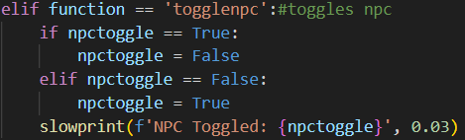
Togglenpc
Toggles the npc
Prints out the status

Slide 22
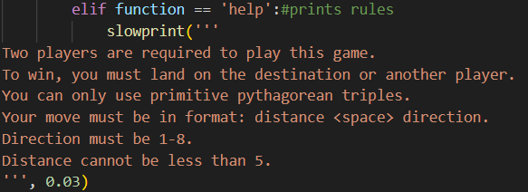
help
Prints rules of the game

Slide 23
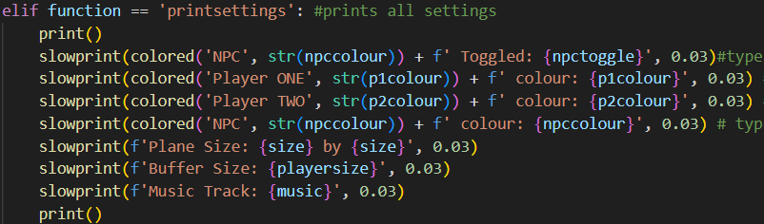
printsettings
Prints all the settings
Uses f strings
I had to use #ignore because it kept breaking

Slide 24
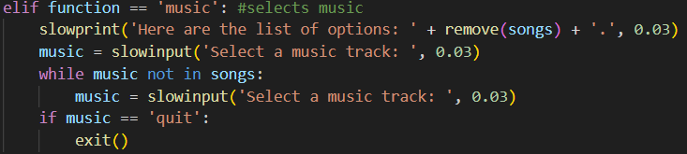
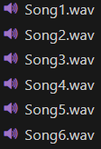
music
Selects a music track
Loads in start function
Uses .wav files

Slide 25
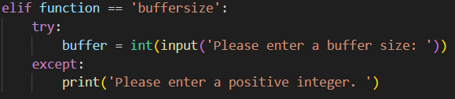
buffersize
Changes the size of the buffer
Can be any size (yes you can make it
bigger than the plane)

Slide 26
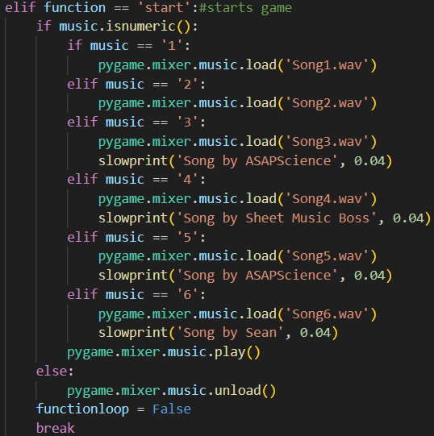
start
Loads the songs from music
Starts the game/breaks the function loop

Slide 27
Stats

Slide 28
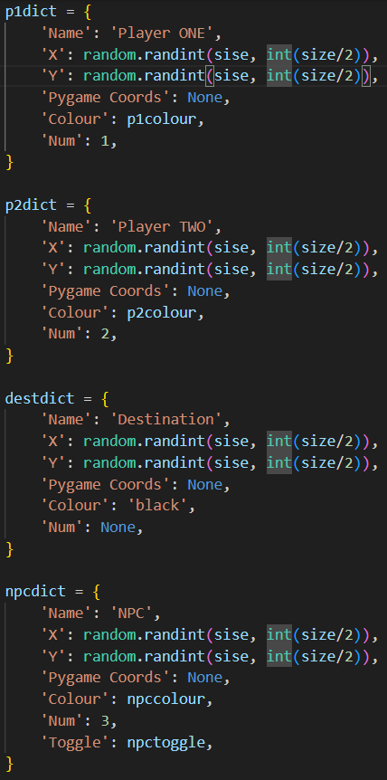
Dictionaries
4 dictionaries
One for player one, two, destination and npc
Destination doesn’t have a number
Npc also has Toggle

Slide 29
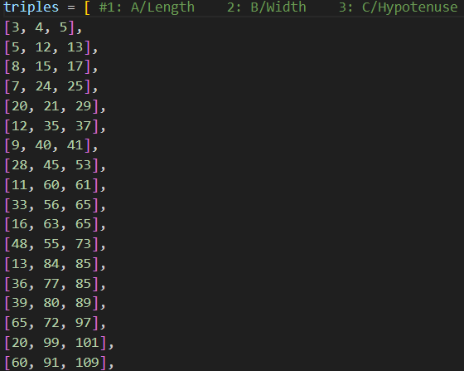
Triples
1st number is length
2nd number is the width
3rd number is the hypotenuse
This is imported to my main file

Slide 30
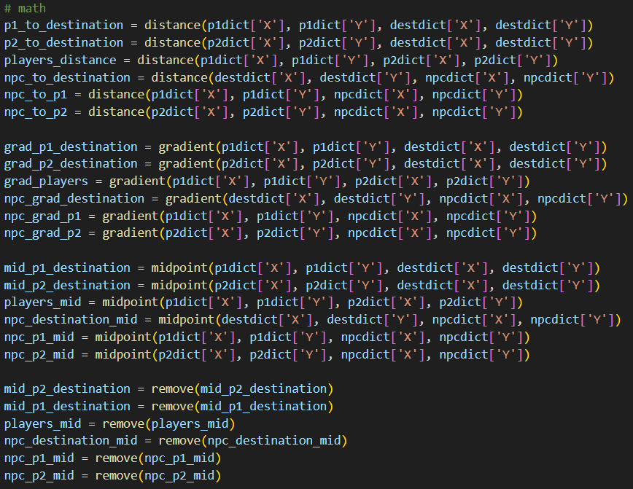
Maths (hooray…)
Uses most of my functions
Calculates distance, gradient and midpoint of all players
Turns midpoint coords into a string

Slide 31
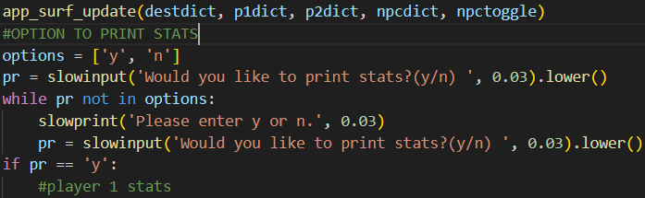
Printing Stats
Printing stats is not
compulsory in my code as
there is a lot to print
All stats are printed underneath the if statement, but it can’t fit in one screenshot so I didn’t put it in

Slide 32
Game Loop

Slide 33
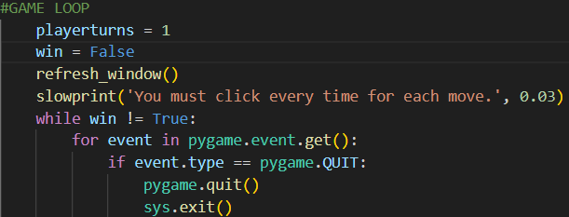
Loops
Sets the playerturn to one
Sets win to False
Tells the user that they must click for each move
Gets the pygame event
If pygame is closed, then the code will end

Slide 34
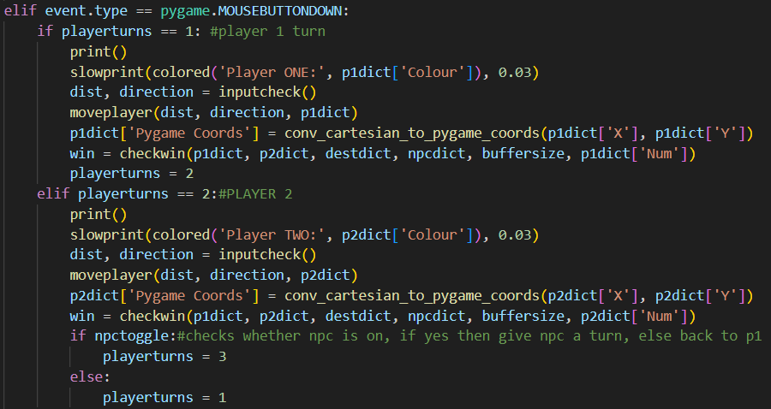
Player Turns
If the user clicks in the pygame window, it will print out the user input
In player 2, if npc is toggled it will give the npc a turn, otherwise it will go back to player one
Uses inputcheck, moveplayer and checkwin

Slide 35
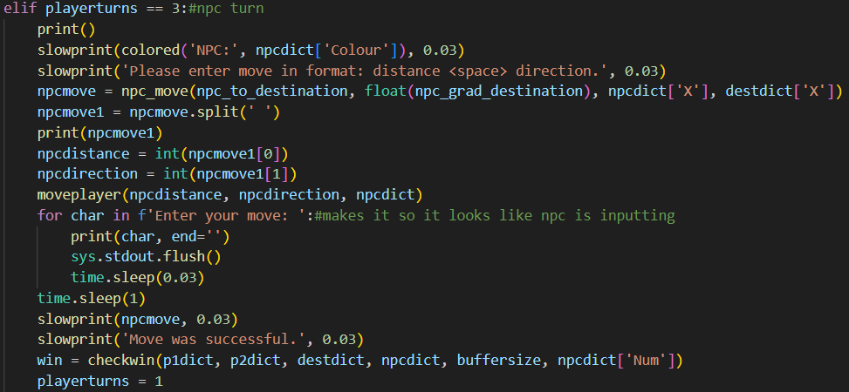
NPC
The npc turn looks just like a
normal player turn, but it inputs
by itself
Uses npc_move to calculate the best move
Then loops back to player 1

Slide 36
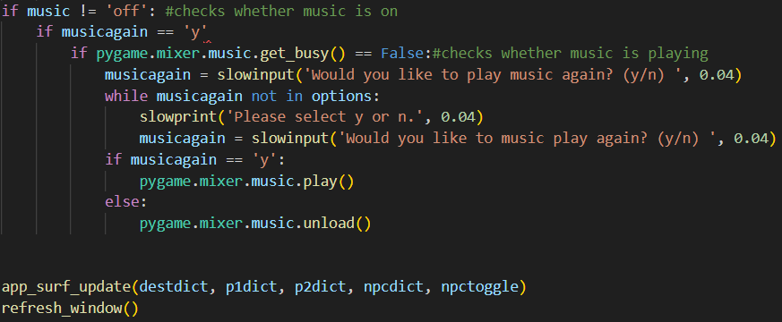
Music + something else
If music is on, then it will check whether there is sound playing
If there isn’t, it will ask the user whether they want to play music again
Also has app_surf_update and refresh_window at the bottom

Slide 37
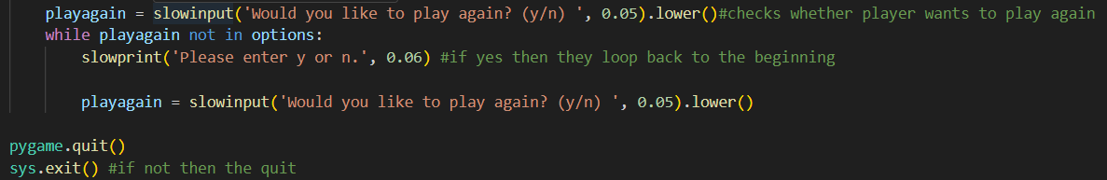
Play again and quit
If the player wants to play again they can
Otherwise the code will make them automatically quit
(ignore the empty line)

Slide 38
THE END
Thanks to Sean Chan and Mr Kigodi for helping out with my code

